Slide 1
Q-Section Error Correcting Codes for PAPR Reduction
Speaker : Te-Sheng Fan
Advisor : Prof. Mao-Chao Lin
Date : 2020.07.16

Slide 2
Outline
Introduction of PAPR Issue
Some Reduction Techniques
System Model
Q-section Error Correcting Codes
Non-Coherent Block Coding (NBC)
Example of Polar-Coded Partial Transmit Sequence (PTS) Scheme for PAPR Reduction
Resolving Phase Ambiguity via Q-section ECC
A General Representation for Q-section Polar Codes
Example of 16-Section Polar-Coded OFDM System

Slide 3
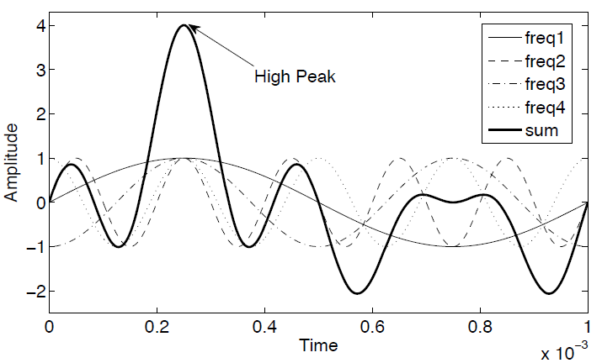

Peak-to-Average Power Ratio (PAPR)
In single-carrier systems, the transmitted signal only depends on one data symbol, hence its power vary in a small range. However, the transmitted signal of multi-carrier system such as OFDM is the summation of all the subcarriers, result in high PAPR of transmitted signal.
For the discrete-time OFDM signal, PAPR is expressed as $PAPR=\frac{\max_{0≤n≤N−1}{{\left|x\left[n\right]\right|}^{2}}}{E[{\left|x\left[n\right]\right|}^{2}]}$ where $E[∙]$ is the expectation operator.
When the independently modulated subcarriers are added coherently, the instantaneous power will be more than the average power
$$(1)$$
[1] Rahmatallah, Y., Mohan, S.: ‘Peak-to-average power ratio reduction in OFDM systems: a survey and taxonomy’, IEEE Commun. Surv. Tutor., 2013, 15, (4), pp. 1567–1592

Slide 4
Such a high PAPR demands high dynamic range in power amplifier (PA). If not biased properly, the PA easily enters into saturation, causing nonlinear amplification of signal (spectral growth of intermodulation among subcarriers and out-of-band radiation). To accommodate this issue, the PA must work at an operating point $P_{i,avg}$, i.e., a large input back-off (IBO) caused inefficient power conversion.
To ensure that the amplified peaks of the OFDM signal do not exceed the saturation level, IBO should be at least equal to PAPR.
Output power(dB)
Ideal Operation Point
Linear Region
$$P_{o,avg}$$
$$P_{o,sat}$$
Actual Operation Point
Saturation Region
IBO
Input power(dB)
$$P_{i,avg}$$
$$P_{i,sat}$$

Slide 5
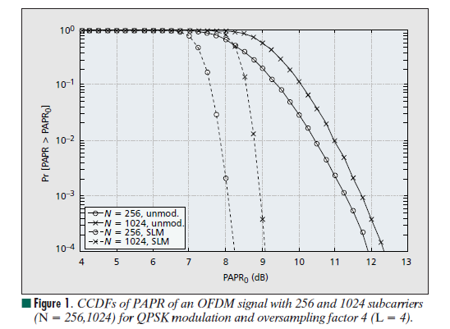
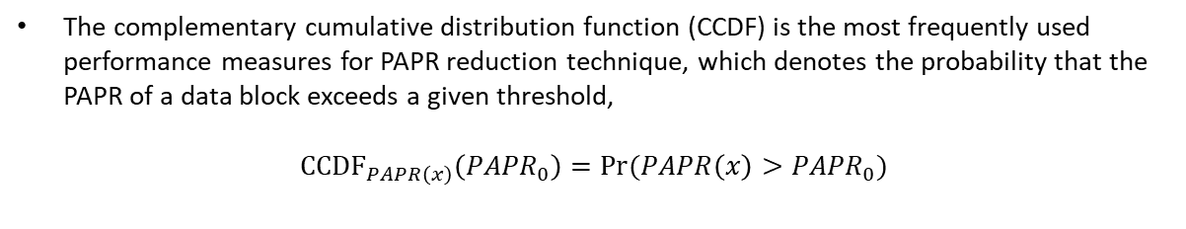

CCDF of the PAPR
The complementary cumulative distribution function (CCDF) is the most frequently used performance measures for PAPR reduction technique, which denotes the probability that the PAPR of a data block exceeds a given threshold,
$${CCDF}_{PAPR\left(x\right)}\left({PAPR}_{0}\right)=Pr⁡(PAPR\left(x\right)>{PAPR}_{0})$$
$$(2)$$
[2] S.H. Han and J.H. Lee, “An overview of peak-to-average power ratio reduction techniques for multicarrier transmission,” IEEE Wireless Comm., vol. 12, pp. 56–65, Apr. 2005.

Slide 6
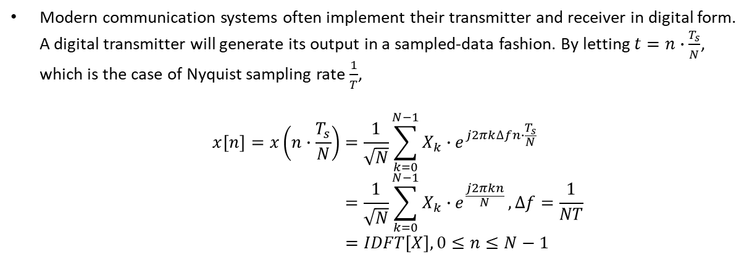

Discrete-Time OFDM Signal
Modern communication systems often implement their transmitter and receiver in digital form. A digital transmitter will generate its output in a sampled-data fashion. By letting $t=n∙\frac{T_{s}}{N}$, which is the case of Nyquist sampling rate $\frac{1}{T}$,
$$x\left[n\right]=x\left(n∙\frac{T_{s}}{N}\right)=\frac{1}{\sqrt{N}}\sum_{k=0}^{N−1}{X_{k}∙e^{j2πk∆fn∙\frac{T_{s}}{N}}} \\ =\frac{1}{\sqrt{N}}\sum_{k=0}^{N−1}{X_{k}∙e^{\frac{j2πkn}{N}}},∆f=\frac{1}{NT} \\ =IDFT\left[X\right], 0≤n≤N−1$$
$$(3)$$

Slide 7
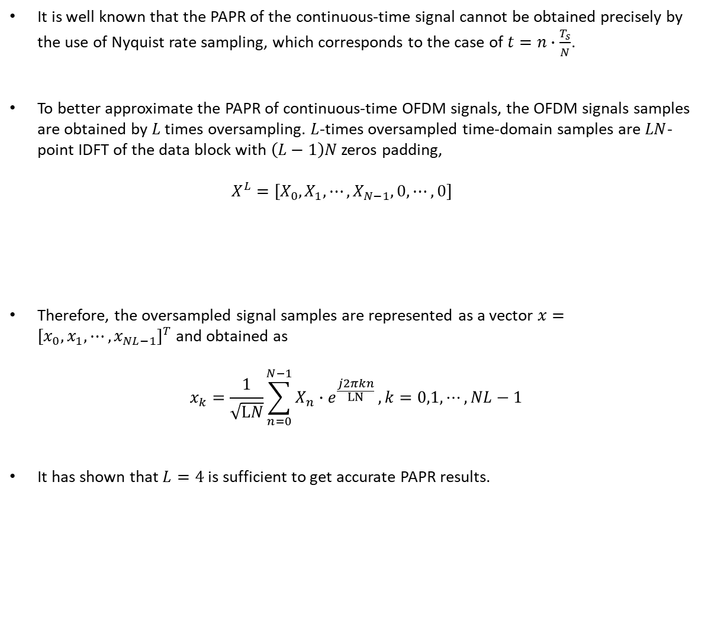

It is well known that the PAPR of the continuous-time signal cannot be obtained precisely by the use of Nyquist rate sampling, which corresponds to the case of $t=n∙\frac{T_{s}}{N}$.
To better approximate the PAPR of continuous-time OFDM signals, the OFDM signals samples are obtained by $L$ times oversampling. $L$-times oversampled time-domain samples are $LN$-point IDFT of the data block with $\left(L−1\right)N$ zeros padding, $X^{L}=[X_{0},X_{1},⋯,X_{N−1},0,⋯,0]$
Therefore, the oversampled signal samples are represented as a vector $x={[x_{0},x_{1},⋯,x_{NL−1}]}^{T}$ and obtained as
$$x_{k}=\frac{1}{\sqrt{LN}}\sum_{n=0}^{N−1}{X_{n}∙e^{\frac{j2πkn}{LN}}}, k=0,1,⋯,NL−1$$
It has shown that $L=4$ is sufficient to get accurate PAPR results.
$\left(L−1\right)N$ zeros
$$(4)$$

Slide 8
PAPR Reduction Techniques
There are many factors that should be considered before a specific PAPR reduction technique is chosen. These factors include PAPR reduction capability, power increase in transmit signal, BER increase at the receiver, loss in data rate, computational complexity increase, and so on.
Next, we briefly present some of the important PAPR reduction techniques with some examples.
PAPR Reduction Techniques
Signal Distortion
Multiple Signaling & Probabilistic
Coding
Clipping & Filtering
SLM
Linear Block Coding
PTS
ACE
[3] Jiang, T., and Wu, Y.Y.: ‘An overview: peak-to-average power ratio reduction techniques for OFDM signals’, IEEE Trans. Broadcast., 2008, 54, (3), pp. 257–268

Slide 9
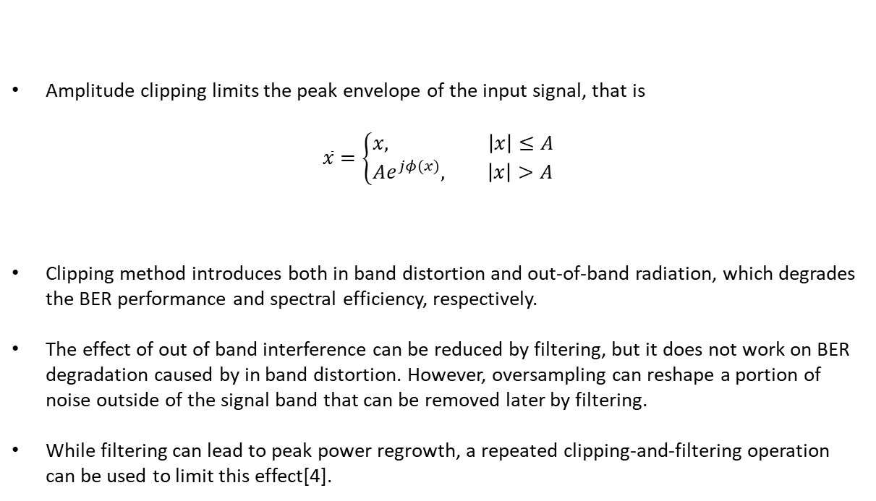

Amplitude Clipping and Filtering
Amplitude clipping limits the peak envelope of the input signal, that is
$$\overline{x}=\left\{\begin{aligned}x, \left|x\right|≤A \\ Ae^{jφ(x)}, \left|x\right|>A\end{aligned}\right.$$
Clipping method introduces both in band distortion and out-of-band radiation, which degrades the BER performance and spectral efficiency, respectively.
The effect of out of band interference can be reduced by filtering, but it does not work on BER degradation caused by in band distortion. However, oversampling can reshape a portion of noise outside of the signal band that can be removed later by filtering.
While filtering can lead to peak power regrowth, a repeated clipping-and-filtering operation can be used to limit this effect[4].
$$(5)$$
where $φ\left(x\right)$ is the phase of $x$.
[4] S. K. Deng and M. C. Lin, “Recursive clipping and filtering with bounded distortion for PAPR reduction,” IEEE Trans. Commun., vol. 55, no. 1, pp. 227–230, January 2007.

Slide 10
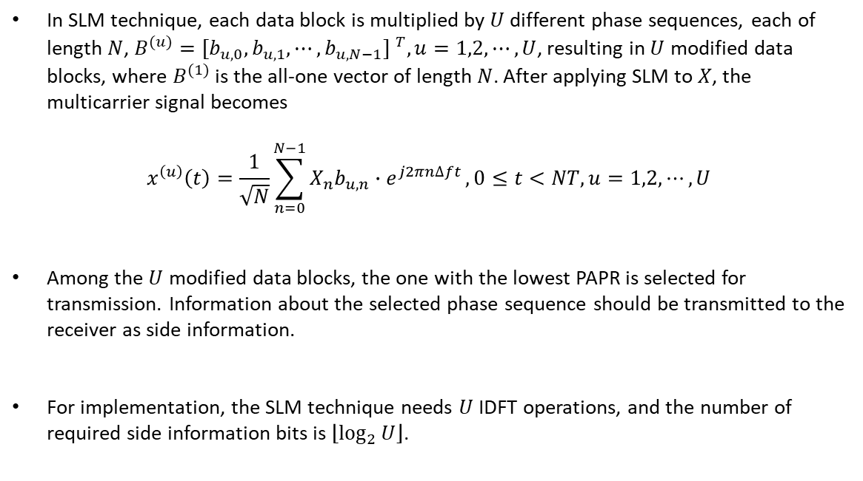

Selected Mapping (SLM)
In SLM technique, each data block is multiplied by $U$ different phase sequences, each of length $N$, $B^{(u)}={[b_{u,0},b_{u,1},⋯,b_{u,N−1}] }^{T}, u=1,2,⋯,U$, resulting in $U$ modified data blocks, where $B^{(1)}$ is the all-one vector of length $N$. After applying SLM to $X$, the multicarrier signal becomes
$$x^{\left(u\right)}\left(t\right)=\frac{1}{\sqrt{N}}\sum_{n=0}^{N−1}{X_{n}b_{u,n}∙e^{j2πn∆ft}},0≤t<NT, u=1,2,⋯,U$$
Among the $U$ modified data blocks, the one with the lowest PAPR is selected for transmission. Information about the selected phase sequence should be transmitted to the receiver as side information.
For implementation, the SLM technique needs $U$ IDFT operations, and the number of required side information bits is $\left\lfloor \log_{2}{U}\right\rfloor$.
$$(6)$$
[5] H. Breiling, S. H. Müller–Weinfurtner, and J. B. Huber, “SLM Peak-Power Reduction without Explicit Side Information,” IEEE Commun. Lett., vol. 5, no. 6, June 2001, pp. 239–41.

Slide 11
Selected Mapping (SLM)
$$B^{(1)}$$
Partition into blocks and serial to parallel conversion
$$⊗$$
$$X^{(1)}$$
IDFT
$$x^{(1)}$$
Select one with minimum PAPR
$$B^{(2)}$$
Data
Source
$$X$$
$$⊗$$
$$X^{(2)}$$
IDFT
$$x^{(2)}$$
$$x$$
$$⋮$$
$$⋮$$
$$B^{(U)}$$
$$X^{(U)}$$
IDFT
$$x^{(U)}$$
$$⊗$$

Slide 12
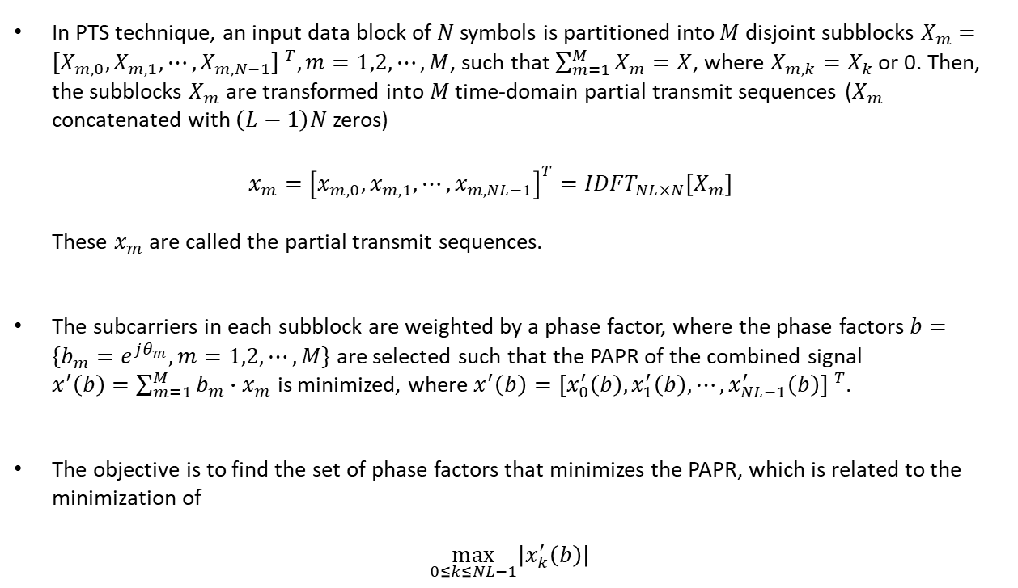

Partial Transmit Sequence (PTS)
In PTS technique, an input data block of $N$ symbols is partitioned into $M$ disjoint subblocks $X_{m}={[X_{m,0},X_{m,1},⋯,X_{m,N−1}] }^{T},m=1,2,⋯,M$, such that $\sum_{m=1}^{M}{X_{m}=X}$, where $X_{m,k}=X_{k}$ or 0. Then, the subblocks $X_{m}$ are transformed into $M$ time-domain partial transmit sequences ($X_{m}$ concatenated with $\left(L−1\right)N$ zeros) $x_{m}={\left[x_{m,0},x_{m,1},⋯,x_{m,NL−1}\right]}^{T}={IDFT}_{NL×N}\left[X_{m}\right]$ These $x_{m}$ are called the partial transmit sequences.
The subcarriers in each subblock are weighted by a phase factor, where the phase factors $b=\{b_{m}=e^{jθ_{m}},m=1,2,⋯,M\}$ are selected such that the PAPR of the combined signal $x^{′}\left(b\right)=\sum_{m=1}^{M}{b_{m}∙x_{m}}$ is minimized, where $x^{′}\left(b\right)={[x_{0}^{′}\left(b\right),x_{1}^{′}\left(b\right),⋯,x_{NL−1}^{′}\left(b\right)] }^{T}$.
The objective is to find the set of phase factors that minimizes the PAPR, which is related to the minimization of
$$\max_{0≤k≤NL−1}\left|x_{k}^{′}\left(b\right)\right|$$
$$(7)$$
[6] X.Li and L.J.Cimini, ”Effect of clipping and filtering on the performance of OFDM,” IEEE Commun. Lett., vol.2, no.5, pp.131-133, May 1998.

Slide 13
Partial Transmit Sequence (PTS)
$$X_{1}$$
$$∙$$
$$b_{1}$$
Partition into blocks and serial to parallel conversion
Division into subblocks
IDFT
$$⊗$$
$$+$$
$$X_{2}$$
IDFT
$$∙$$
$$b_{2}$$
Data
Source
$$X$$
$$⊗$$
$$x^{′}(b)$$
$$⋮$$
$$⋮$$
$$X_{M}$$
$$∙$$
$$b_{M}$$
IDFT
$$⊗$$
Optimization for b
If necessary Side information

Slide 14
Active Constellation Extension (ACE)
The shaded region represents the increased margin for the data symbol in the first quadrant.
$$×$$
$$×$$
nominal constellation point
$$×$$
$$×$$
The region extend to infinity (extended area).

Slide 15
16-QAM Constellation with Gray Mapping
$$∙$$
$$∙$$
$$(x_{2},x_{3})$$
$$∙$$
$$∙$$
0000
0100
1100
1000
$$∙$$
$$∙$$
$$∙$$
$$∙$$
0001
0101
1101
1001
In order to main the minimum distance, inward extension is disallow (ACE constraint)
$$(x_{0},x_{1})$$
$$∙$$
$$∙$$
$$∙$$
$$∙$$
0011
0111
1111
1011
$$∙$$
$$∙$$
$$∙$$
$$∙$$
0010
0110
1110
1010

Slide 16
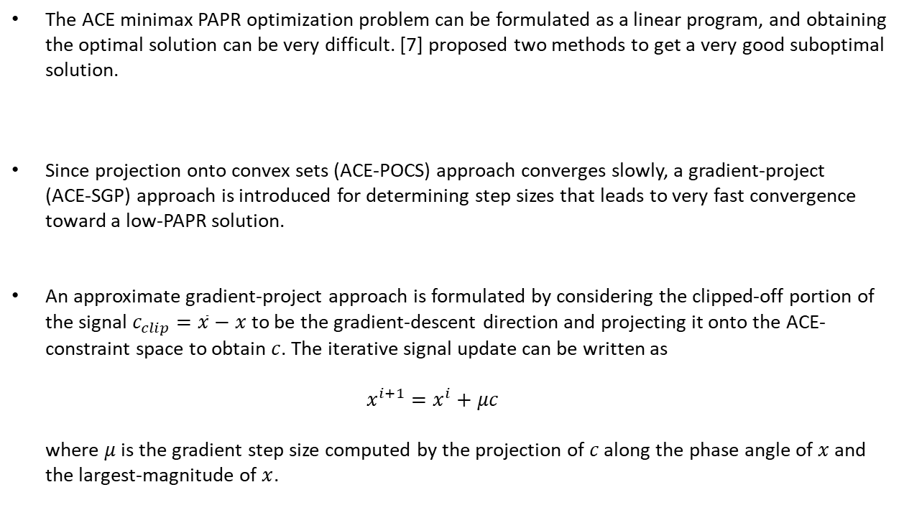
Practical ACE Implementation
The ACE minimax PAPR optimization problem can be formulated as a linear program, and obtaining the optimal solution can be very difficult. [7] proposed two methods to get a very good suboptimal solution.
Since projection onto convex sets (ACE-POCS) approach converges slowly, a gradient-project (ACE-SGP) approach is introduced for determining step sizes that leads to very fast convergence toward a low-PAPR solution.
An approximate gradient-project approach is formulated by considering the clipped-off portion of the signal $c_{clip}=\overline{x}−x$ to be the gradient-descent direction and projecting it onto the ACE-constraint space to obtain $c$. The iterative signal update can be written as $x^{i+1}=x^{i}+μc$ where $μ$ is the gradient step size computed by the projection of $c$ along the phase angle of $x$ and the largest-magnitude of $x$.
[7] B. S. Krongold and D. L. Jones, "PAR reduction in OFDM via active constellation extension," in IEEE Transactions on Broadcasting, vol. 49, no. 3, pp. 258-268, Sept. 2003.

Slide 17
Coding
Coding can also be used to reduce the PAPR, the idea is illustrated in the following example.
This approach suffers from the need to perform an exhaustive search to find the best code and to store large lookup tables for encoding and decoding. Moreover, the main disadvantage of this method is the good performance of the PAPR reduction at the cost of coding rate loss.
Data block X | PAPR (dB) | Data block X | PAPR (dB)
[1,1,1,1] | 6.0 | [-1,1,1,1] | 2.3
[1,1,1,-1] | 2.3 | [-1,1,1,-1] | 3.7
[1,1,-1,1] | 2.3 | [-1,1,-1,1] | 6.0
[1,1,-1,-1] | 3.7 | [-1,1,-1,-1] | 2.3
[1,-1,1,1] | 2.3 | [-1,-1,1,1] | 3.7
[1,-1,1,-1] | 6.0 | [-1,-1,1,-1] | 2.3
[1,-1,-1,1] | 3.7 | [-1,-1,-1,1] | 2.3
[1,-1,-1,-1] | 2.3 | [-1,-1,-1,-1] | 6.0
[8] S. B. Slimane, “Reducing the peak-to-average power ratio of OFDM signals through precoding,” IEEE Trans. Veh. Technol., vol. 56, no. 2, pp. 686–695, March 2007.

Slide 18
The Proposed System Model
Q-section code
PAPR reduction
data
Q-ECC
encoder
QAM
modulation
IFFT
channel
recovered data
Q-ECC
decoder
de-
modulation
FFT

Slide 19
Introduction of PAPR Issue
Some Reduction Techniques
System Model
Q-section Error Correcting Codes
Non-Coherent Block Coding (NBC)
Example of Polar-Coded Partial Transmit Sequence (PTS) Scheme for PAPR Reduction
Q-Section LDPC Codes Design
Encoding/Decoding Procedure
Protograph-Based LDPC
The Proposed Q-section PEG (Q-PEG)

Slide 20





Non-Coherent Block Coding
Assume that $C$ is a $(n,k)$ linear block code with generator matrix $G$ that contains an all-one row $g_{a}$.
With $g_{a}$, the data were protected from length-$n$ phase ambiguity, since both codeword $c$and phase-corrupted received vector $r$ correspond to the same data (vector $m$ without $m_{a}$).
By the Non-Coherent Block Coding (NBC) technique, the effect of error propagation in differential encoding can be avoided.
$$G=\left[\begin{matrix}g_{1} \\ g_{2} \\ ⋮ \\ g_{a} \\ ⋮ \\ g_{k}\end{matrix}\right]=\left[\begin{matrix} & & & \\ & ⋱ & & \\ & & ⋱ & \\ 1 & ⋯ & 1 & 1 \\ & ⋱ & & \\ & & ⋱ & \end{matrix}\right]$$
$$m=[m_{1},m_{2},⋯,m_{a},⋯,m_{k}]$$
channel with phase ambiguity
$$c=[c_{1},c_{2},⋯,c_{n}]$$
$$r=[r_{1},r_{2},⋯,r_{n}]$$
[9] Ruey-Yi Wei, "Noncoherent block-coded MPSK," in IEEE Transactions on Communications, vol. 53, no. 6, pp. 978-986, June 2005.

Slide 21

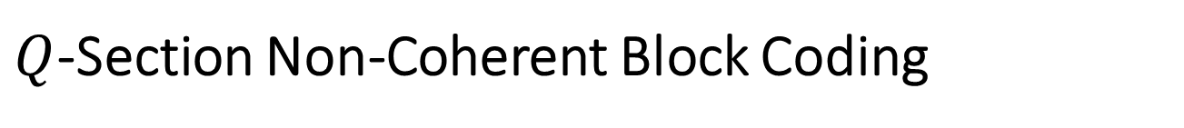




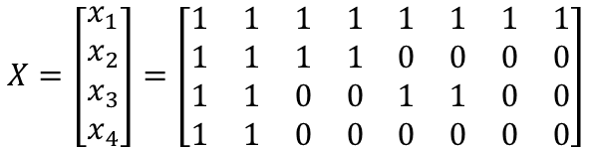

$Q$-Section Non-Coherent Block Coding
The codeword $c$ is splitted into Q-section if $G$ contains a vector set $X$, which has Q vectors each with section-wise all one property.
The $Q$-section NBC vector $X$ can be represented by $X={[x_{1},x_{2},⋯,x_{Q}] }^{T}$. For example, $n=8$ and $Q=4$, we have each section contains two bits, where $X$ is the subset of $G$ containing the basic Q-section NBC vectors, and $\tilde{G}$ represents the remaining rows of $G$.
The structure of Q-section NBC is very similar to the generator of Reed-Muller code.
$$X=\left[\begin{matrix}x_{1} \\ x_{2} \\ x_{3} \\ x_{4}\end{matrix}\right]=\left[\begin{matrix}1 & 1 & 1 & 1 & 1 & 1 & 1 & 1 \\ 1 & 1 & 1 & 1 & 0 & 0 & 0 & 0 \\ 1 & 1 & 0 & 0 & 1 & 1 & 0 & 0 \\ 1 & 1 & 0 & 0 & 0 & 0 & 0 & 0\end{matrix}\right]$$
$$G=\left[\begin{matrix}\tilde{G} \\ X\end{matrix}\right]$$
$$S_{1}$$
$$S_{2}$$
$$S_{3}$$
$$S_{4}$$

Slide 22
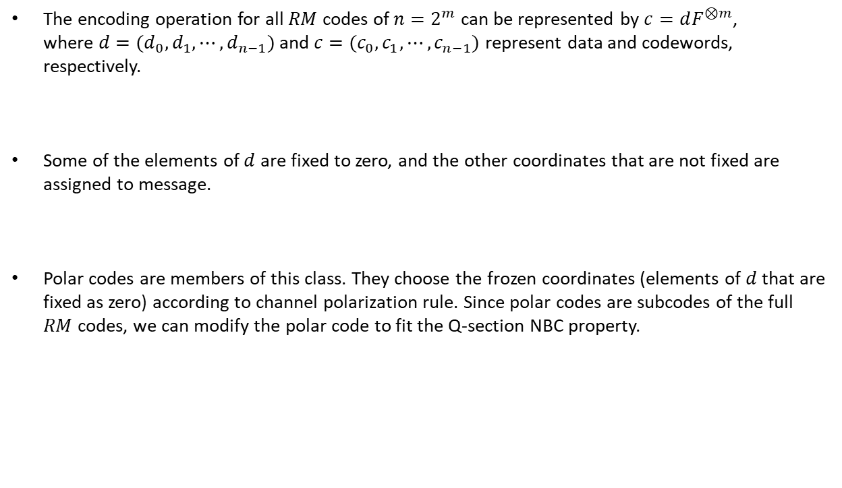
The encoding operation for all $RM$ codes of $n=2^{m}$ can be represented by $c=dF^{⊗m}$, where $d=(d_{0},d_{1},⋯,d_{n−1})$ and $c=(c_{0},c_{1},⋯,c_{n−1})$ represent data and codewords, respectively.
Some of the elements of $d$ are fixed to zero, and the other coordinates that are not fixed are assigned to message.
Polar codes are members of this class. They choose the frozen coordinates (elements of $d$ that are fixed as zero) according to channel polarization rule. Since polar codes are subcodes of the full $RM$ codes, we can modify the polar code to fit the Q-section NBC property.
[10] E. Arikan, "A survey of reed-muller codes from polar coding perspective," 2010 IEEE Information Theory Workshop on Information Theory (ITW 2010, Cairo), Cairo, 2010.

Slide 23
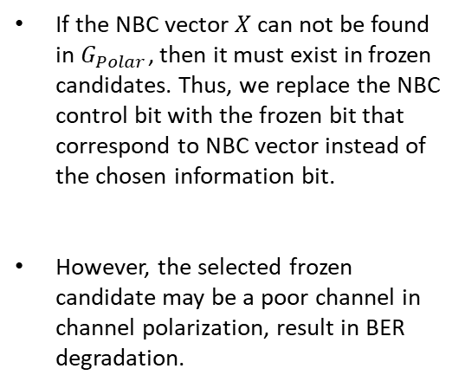
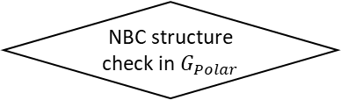
Input the design parameter (e.g., SNR, Bhattacharyya)
Polar code construction
yes
NBC structure check in $G_{Polar}$
no
If the NBC vector $X$ can not be found in $G_{Polar}$, then it must exist in frozen candidates. Thus, we replace the NBC control bit with the frozen bit that correspond to NBC vector instead of the chosen information bit.
However, the selected frozen candidate may be a poor channel in channel polarization, result in BER degradation.
NBC structure check in frozen bits
Replace the information bit that correspond to NBC vector as the NBC control bit
Replace the frozen bit that correspond to NBC vector as the NBC control bit
End

Slide 24
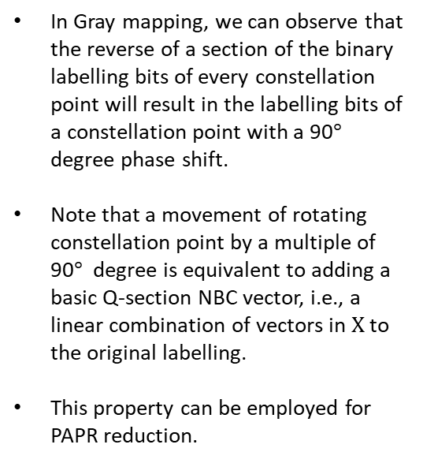
PAPR Control
16-QAM Constellation with Gray Mapping
$$∙$$
$$∙$$
$$(x_{2},x_{3})$$
$$∙$$
$$∙$$
In Gray mapping, we can observe that the reverse of a section of the binary labelling bits of every constellation point will result in the labelling bits of a constellation point with a 90$°$ degree phase shift.
Note that a movement of rotating constellation point by a multiple of 90$°$ degree is equivalent to adding a basic Q-section NBC vector, i.e., a linear combination of vectors in $X$ to the original labelling.
This property can be employed for PAPR reduction.
0000
0100
1100
1000
$$∙$$
$$∙$$
$$∙$$
$$∙$$
0001
0101
1101
1001
$$(x_{0},x_{1})$$
$$∙$$
$$∙$$
$$∙$$
$$∙$$
0011
0111
1111
1011
$$∙$$
$$∙$$
$$∙$$
$$∙$$
0010
0110
1110
1010

Slide 25
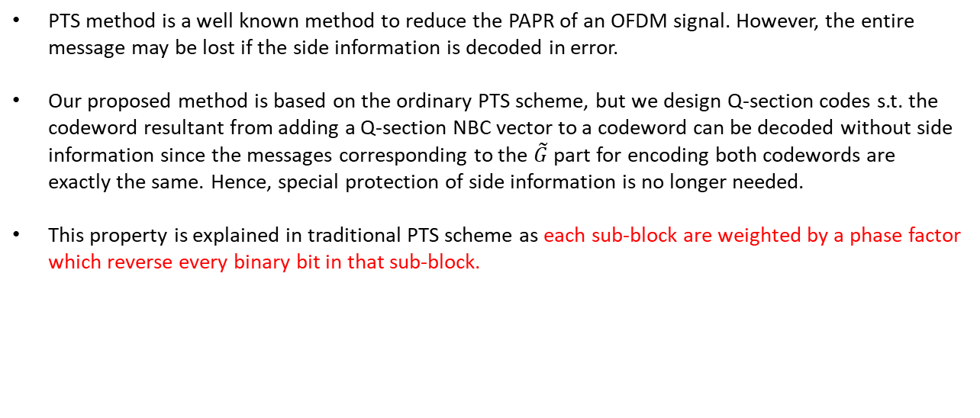
PTS method is a well known method to reduce the PAPR of an OFDM signal. However, the entire message may be lost if the side information is decoded in error.
Our proposed method is based on the ordinary PTS scheme, but we design Q-section codes s.t. the codeword resultant from adding a Q-section NBC vector to a codeword can be decoded without side information since the messages corresponding to the $\tilde{G}$ part for encoding both codewords are exactly the same. Hence, special protection of side information is no longer needed.
This property is explained in traditional PTS scheme as each sub-block are weighted by a phase factor which reverse every binary bit in that sub-block.
Q-section control
$$X_{1}$$
$$∙$$
$$b_{1}$$
Partition into blocks and serial to parallel conversion
Division into subblocks
IDFT
$$⊗$$
$$+$$
$$X_{2}$$
IDFT
$$∙$$
$$b_{2}$$
Data
Source
$$X$$
$$⊗$$
$$x^{′}(b)$$
$$⋮$$
$$⋮$$
$$X_{Q}$$
$$∙$$
$$b_{Q}$$
IDFT
$$⊗$$
Select one with minimum PAPR

Slide 26
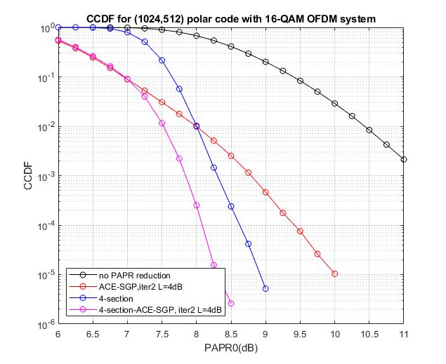

Slide 27
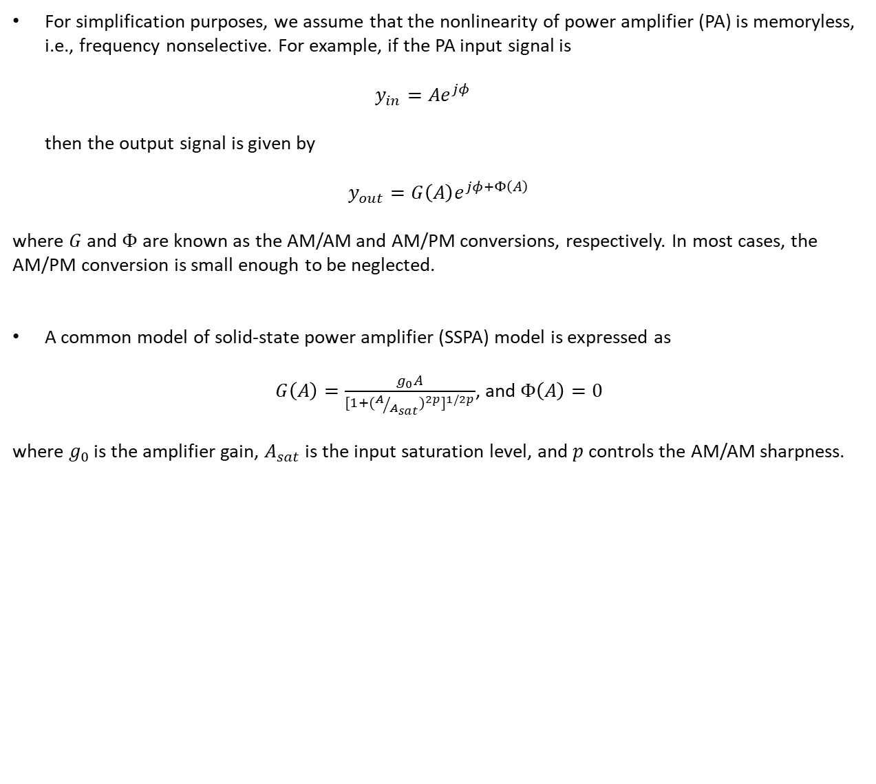
The Power Amplifier Model
For simplification purposes, we assume that the nonlinearity of power amplifier (PA) is memoryless, i.e., frequency nonselective. For example, if the PA input signal is $y_{in}=Ae^{jφ}$ then the output signal is given by
$$y_{out}=G\left(A\right)e^{jφ+Φ\left(A\right)}$$
where $G$ and $Φ$ are known as the AM/AM and AM/PM conversions, respectively. In most cases, the AM/PM conversion is small enough to be neglected.
A common model of solid-state power amplifier (SSPA) model is expressed as
$G\left(A\right)=\frac{g_{0}A}{{[1+{(A/{A_{sat}})}^{2p}]}^{1/2p}}$, and $Φ\left(A\right)=0$
where $g_{0}$ is the amplifier gain, $A_{sat}$ is the input saturation level, and $p$ controls the AM/AM sharpness.

Slide 28




The Power Amplifier Model
We assumed that $g_{0}=1$, and a good approximation of practical PA is obtained by choosing $p$ in the range of 2 to 3. The $A_{sat}$ can be obtained by [10]
$$P_{in}=\frac{{A_{sat}}^{2}}{IBO}$$
We can further simplify this model into a hard clipping scheme,
OFDM Symbol
$$⊗$$
Hard clipping
$$⊕$$
IBO control
AWGN
Clipping level$=\sqrt{E[{\left|s_{n}\right|}^{2}]}=\frac{1}{\sqrt{L}}=\frac{1}{2}$

Slide 29
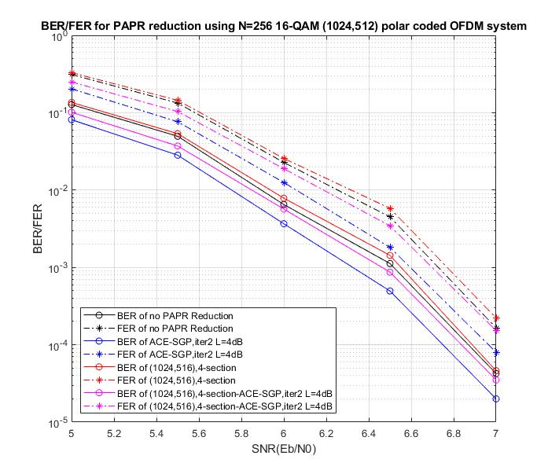

Slide 30

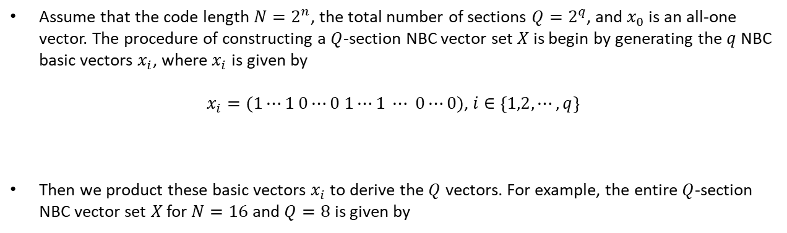
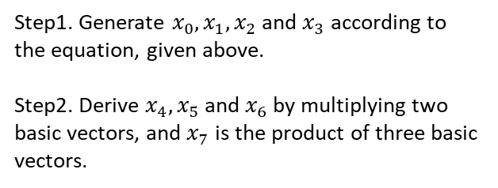
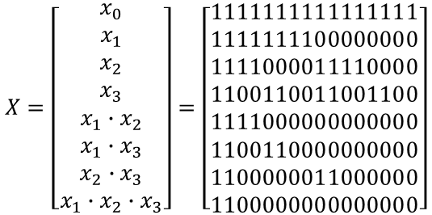
General Representation for Q-section Polar Codes
Assume that the code length $N=2^{n}$, the total number of sections $Q=2^{q}$, and $x_{0}$ is an all-one vector. The procedure of constructing a $Q$-section NBC vector set $X$ is begin by generating the $q$ NBC basic vectors $x_{i}$, where $x_{i}$ is given by
$x_{i}=(1⋯1 0⋯0 1⋯1 ⋯ 0⋯0)$, $i∈\left\{1,2,⋯,q\right\}$
Then we product these basic vectors $x_{i}$ to derive the $Q$ vectors. For example, the entire $Q$-section NBC vector set $X$ for $N=16$ and $Q=8$ is given by
$$2^{n−i}$$
$$2^{n−i}$$
$$2^{n−i}$$
$$2^{n−i}$$
$$X=\left[\begin{matrix}x_{0} \\ x_{1} \\ x_{2} \\ x_{3} \\ x_{1}∙x_{2} \\ x_{1}∙x_{3} \\ x_{2}∙x_{3} \\ x_{1}∙x_{2}∙x_{3}\end{matrix}\right]=\left[\begin{matrix}1111111111111111 \\ 1111111100000000 \\ 1111000011110000 \\ 1100110011001100 \\ 1111000000000000 \\ 1100110000000000 \\ 1100000011000000 \\ 1100000000000000\end{matrix}\right]$$
Step1. Generate $x_{0}, x_{1}, x_{2}$ and $x_{3}$ according to the equation, given above.
Step2. Derive $x_{4}, x_{5}$ and $x_{6}$ by multiplying two basic vectors, and $x_{7}$ is the product of three basic vectors.

